Slide 1


Why did Fed save AIG not Lehman
The Financial Crisis of 2008
National Taiwan University of Science and Technology
Anna Huang
Economic Professor
annaandtommy1004@gmail.com
5/1/2021

Slide 2

1
The Bankruptcy of Lehman Brothers
2
The Financial Crisis of AIG
CONTENTS
3
Comparison of Lehman and AIG

Slide 3

1
The Bankruptcy of Lehman Brothers

Slide 4
Importance of Lehman Brothers
Fourth-largest
investment
Bank
Global
Financial
Services
firm
158
years
25000
employees
worldwide

Slide 5
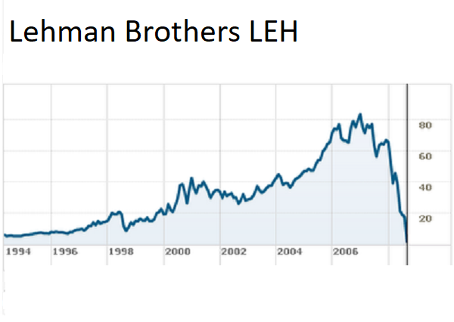
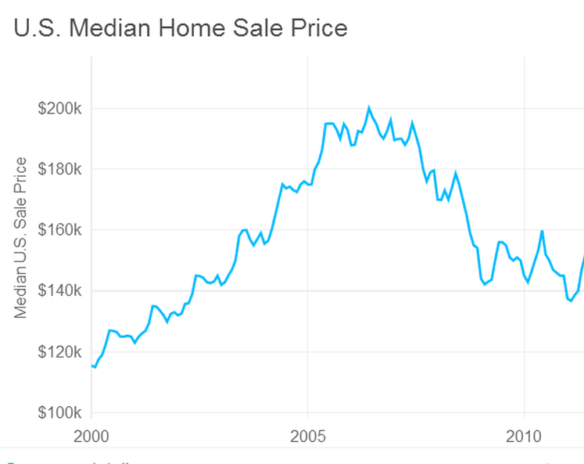
Lehman Brothers’ stock price/US Home Price

Slide 6
Lehman Brothers’ Bankruptcy
9/13
Bank of America – Merrill Lynch
Korean Development Bank – Fail
England Barclays Bank – Blocked
9/15 (Monday)
Opening of Stock Market
9/14
Lehman filed for Bankruptcy

Slide 7
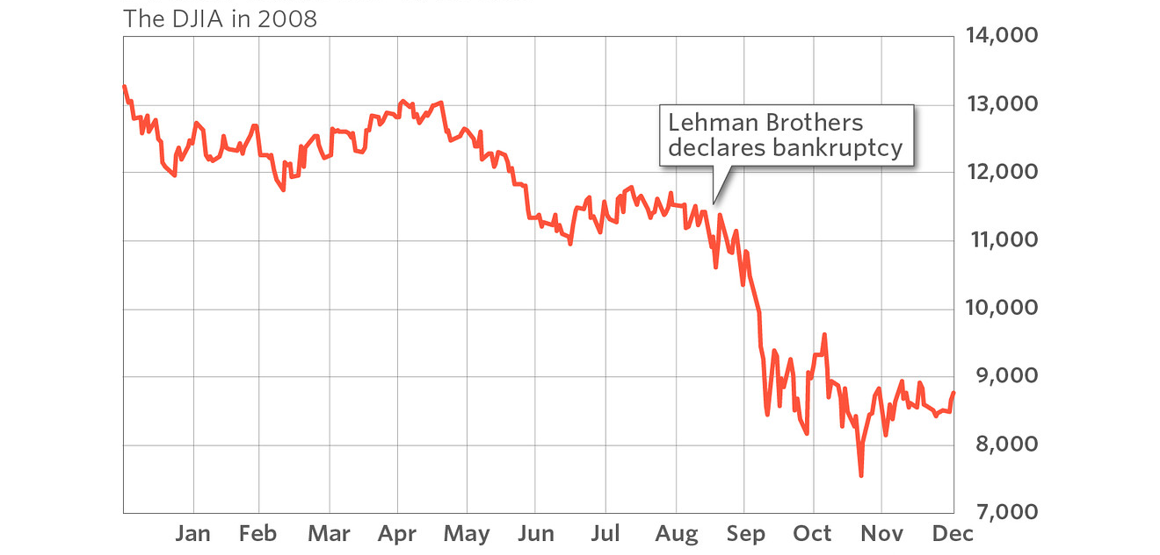
DJIA in 2008

Slide 8
2
The Financial Crisis of AIG

Slide 9
Importance of AIG
Multinational
Finance and
Insurance
Corporation
General
Insurance
80
Countries
Life and Retirement

Slide 10







AIG Financial Crisis
Sold Bundles to Investors
Making Huge Money
Lower Borrowers’ Criteria
Home loan + Mortgage-Backed Securities
AIG Took the Risk
New Securities were Risky
Bought the House

Slide 11
Housing Price Down
Teaser Rate on Borrowers’ Mortgage Ran out
Payments Went up
Housing Price Down
Borrow Defaulted
AIG Paid off Swaps

Slide 12
Rescue AIG
Federal Reserve System gave AIG 85 billions of Emergency Financing.

Slide 13
3
Comparison of Lehman and AIG

Slide 14
Lehman Brothers V.S. AIG
 | Lehman Brothers | AIG
Nature of the Firm | Investment Bank | Insurance Corporation
Money | X | O
Time | First | After

Slide 15
THE END
Thank You for Coming

